Slide 1

STORE ITEM DEMAND PREDICTION
AKHILA GOTTEMUKKULA
MRUDHULA GORREPATI
VINAY VARMA

Slide 2
ROELS AND RESPONSIBILITIES
Three of us made up the team and investigated the efficiency oof deep learning methods for predicting store item demand. Every team member focused on a certain model:
Akhila: Worked on preprocessing the data, adjusting hyperparameters, and training the Recurrent Neural Network(RNN) model. Also heled with the analysis of the findings and the model’s performance evaluation.
Mrudhula: Worked on preprocessing the data, adjusting the hyper parameters and refining the Convolutional Neural Network(CNN) model. Also helped with interpretation and model’s efficiency evaluations.
Vinay Varma: Worked on preprocessing the data, tuning hyperparameters and developing the Long Short-Term Memory(LTSM) model. And contributed with the outcomes and model’s effectiveness.
Writing the paper’s introduction, methods, findings, and discussion sections is a team effort. Together, we also created the presentation that included our findings.

Slide 3
MOTIVATION
The demand for shop items must be predicted in order to maximize supply chain logistics, inventory control, and retail management.
RNN, CNN, LSTM techniques of deep learning have shown stunning results
To determine the most effective method for predicting store item demand, more research must be done on the efficacy of the deep learning algorithms.
By using mean squared error and mean absolute error we can find out the best suitable method for this. Also by finding the best technique we can help the inventory management and decision making.

Slide 4
PROBLEM STATEMENT
The purpose of this research is to use deep learning techniques to accurately estimate store item demand. For merchants to maximize their supply chain operations, inventory management and pricing strategies, demand forecasting accuracy is essential. However, because customer behaviour is so complicated and erratic, standard forecasting techniques might not always give reliable results. In order to determine which deep learning model-such as RNNs, CNNs and LSTMs- is more reliable and beneficial for predicting store item demand, we will investigate their efficacy.

Slide 5
OBJECTIVE
To investigate the feasibility of different methods for estimating store item demand, including RNNs, CNNs,, LSTMs
Need to employ the proper algorithms and approaches to train the deep learning models and preprocess the demand data.
To find out the best technique suitable for forecasting the demand of various items with respective to mean square error or mean absolute error.
To offer merchants information that will help them make well-informed decisions around pricing , supply chain logistics and inventory management.

Slide 6
RELATED WORKS
Demand Forecasting for Walmart Stores" by V. M. Srivastava and S. S. Jha (2015): In this paper, the authors proposed a demand forecasting model based on regression analysis, seasonal decomposition, and Holt-Winters methods.
Time Series Forecasting with LSTM Neural Networks for Demand Prediction in Retail" by Z. Cai, D. Zheng, and Y. Zhao (2018): The authors proposed a demand prediction model based on Long Short-Term Memory (LSTM) neural networks.
Predicting the Sales of Walmart Retail Chain" by S. G. Rehman and S. S. Rizvi (2018): In this paper, the authors proposed a demand prediction model based on autoregressive integrated moving average (ARIMA) and exponential smoothing (ETS) methods.
DeepAR: Probabilistic Forecasting with Autoregressive Recurrent Networks" by D. Salinas, V. Verma, and Y. Bengio (2019): The authors proposed a deep learning model called DeepAR for probabilistic forecasting of time series data, including demand prediction in retail.

Slide 7
PROPOSED SOLUTION
We propose to investigate the effectiveness of deep learning techniques such as RNNs, CNNs, and LSTMs for store item demand forecasting.
These models will be trained using preprocessed demand data and their performance will be assessed using metrics like mean absolute error and mean squared error.
The goal of our suggested solution is to find the best methods for predicting store item demand so that merchants can plan their inventory and handle supply chain logistics with knowledge.
To determine which strategy works best and we also evaluate how well deep learning models perform in comparison to conventional statistical techniques.
Retailers may increase profitability and customer happiness by optimizing their pricing strategies, supply chain logistics and inventory management with the help of our suggested solutions findings.

Slide 8
RESULTS
The performance of the three DL models i.e., RNN, CNN, LSTM is evaluated based on mean square error or mean absolute error.
MODELC | MSE | MAE
RNN | 0.0519 | 0.1946
CNN | 0.0020 | 0.0348
LSTM | 0.0063 | 0.0583

Slide 9
ANALYZING
Out of the three models used, CNN model shows the least errors.
Our findings indicate that the CNN model is the best method for estimating store item demand.
Based on our simulation results, deep learning models appear to be useful instruments for predicting the demand for store items.
Retailers can utilize the CNN model to make well-informed judgements on pricing strategies, supply chain logistics and inventory management.
Retailers may maximize supply chain logistics , inventory management, and pricing strategies by utilizing the results of our study.

Slide 10
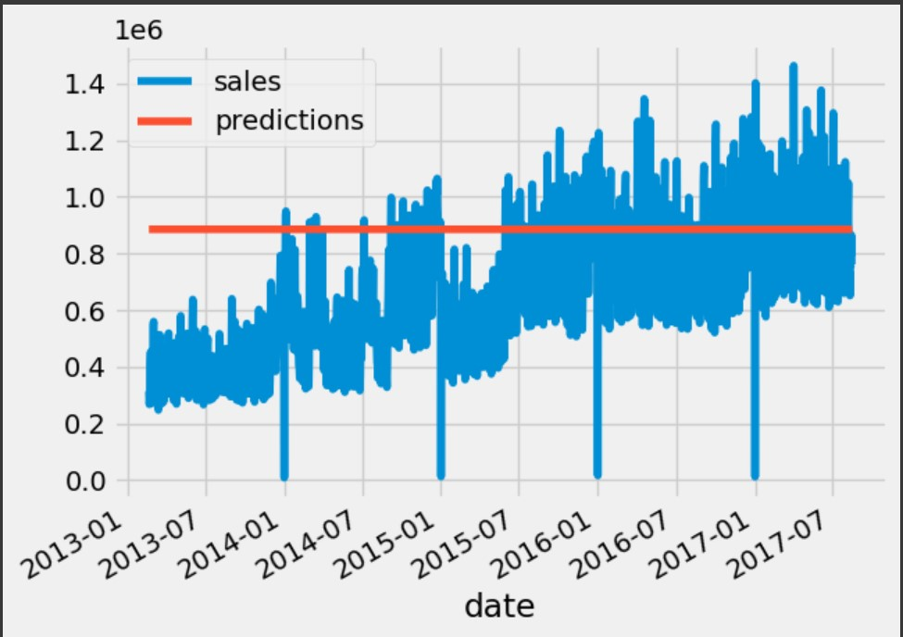
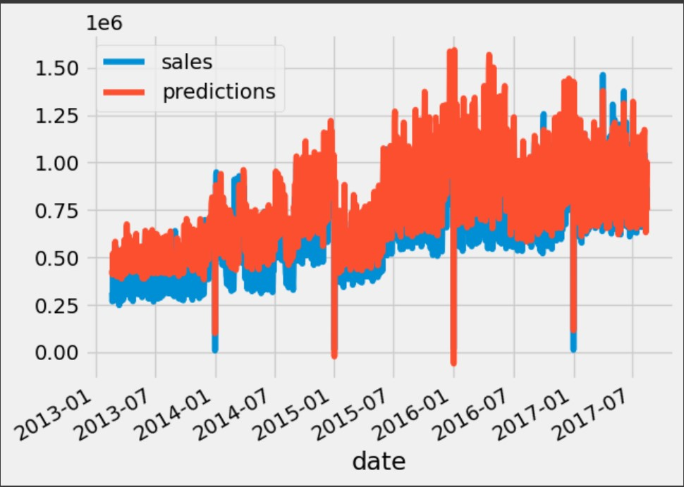
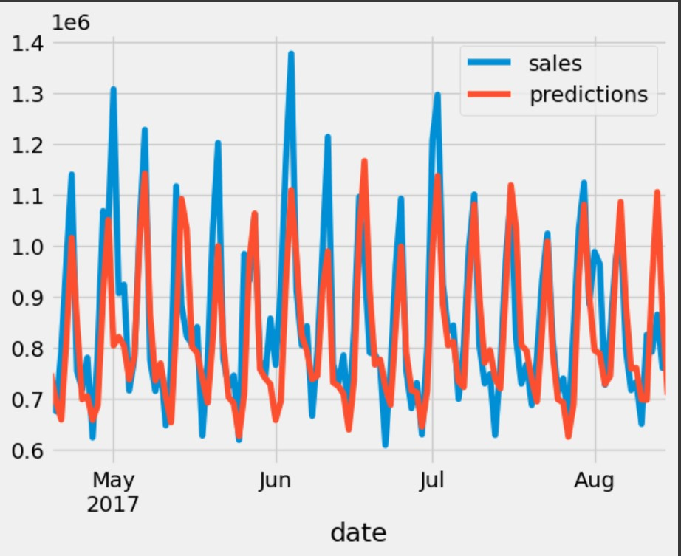
PREDICTION CURVES
RNN: CNN:
LSTM:

Slide 11
REFERENCES
Z. H. Kilimci, A. O. Akyuz, M. Uysal, S. Akyokus, M. O. Uysal, B. A. Bulbul, and M. A. Ekmis, "An Improved Demand Forecasting Model Using Deep Learning Approach and Proposed Decision Integration Strategy for Supply Chain," Complexity, vol. 2019, Article ID 9067367, pp. 1-15, 2019. doi: 10.1155/2019/9067367.
S. S. J. Nithin, T. Rajasekar, S. Jayanthy, K. Karthik and R. R. Rithick, "Retail Demand Forecasting using CNN-LSTM Model," 2022 International Conference on Electronics and Renewable Systems (ICEARS), Tuticorin, India, 2022, pp. 1751-1756, doi: 10.1109/ICEARS53579.2022.9752283.I. S. Jacobs and C. P. Bean, “Fine particles, thin films and exchange anisotropy,” in Magnetism, vol. III, G. T. Rado and H. Suhl, Eds. New York: Academic, 1963, pp. 271–350.
A. Yaseen, S. Saeed, F. Azam, and M. A. Al-Fawzan, "An Improved Demand Forecasting Model Using Deep Learning Approach and Proposed Decision Integration Strategy for Supply Chain," Complexity, vol. 2019, Article ID 9067367, pp. 1-15, 2019. Available: https://www.hindawi.com/journals/complexity/2019/9067367/
Y. Chen, X. Liu, and S. Zeng, "The Study of a Sales Forecast Model Based on SA-LSTM," Journal of Physics: Conference Series, vol. 1314, no. 1, p. 012215, 2019. Available: https://iopscience.iop.org/article/10.1088/1742-6596/1314/1/012215/pdf
V. Veljkovic, T. Gligorijevic, M. Brkic, and M. Milosevic, "Approaching sales forecasting using recurrent neural networks and transformers," in Proceedings of the 2019 27th Telecommunications Forum (TELFOR), Belgrade, Serbia, 2019, pp. 1-4. Available: https://www.semanticscholar.org/reader/d22f2fe8c52fe73e396b109c678ac767d8fcbda1

Slide 12


